Slide 1
Strategy for program level programming
May 22, 2017

Slide 2
Agenda
Define Program
Program management v/s project management
Governance Model
Roles and Responsibilities

Slide 3
Define Program
Development of a drug to be marketed (Laboratory to Patients)
Product Profiling
Clinical Development plan (IND, NDA, BLA, DMC, IA, RMP, DSUR, PSUR/PBRER, BIMO…)
Non-clinical Development Plan (In vitro, Modelling and simulations, Animal studies
Different Health Authority submission strategy (e.g. FDA, EMEA, PMDA, Health Canada, MRP…)
Marketing strategy

Slide 4
Program management v/s project management

Slide 5
Program v/s Project
For Disease/ Indication
Non-clinical Program
In vitro/ Modelling
Animal trials
Clinical Program
Human trials
Sub-Program
Sub-Program
Projects
Phase1 clinical trials
Phase2 clinical trials
Phase 4 clinical trials
Phase 3 clinical trials
Sub-Projects
Drug Development Program
Program
Similarly, there could be more indications within the same program which may split in to multiple projects

Slide 6
Governance Model

Slide 7
Governance Model
For Disease/ Indication
Non-clinical Program
In vitro/ Modelling
Animal trials
Clinical Program
Human trials
Indication Head
Non-clinical Program lead Clinical Program lead
Project leads
Phase1 clinical trials
Phase2 clinical trials
Phase 4 clinical trials
Phase 3 clinical trials
Clinical trial leads
Drug Development Program
Program Head
The governance model is defined in accordance with the eCTD triangle thus ensuring each of the line-functions involved in the program are able to contribute effectively towards the submission.
The over all success of the program depends on the success of each of these project
The over all responsibility of success of the program resides in the Program Head
Financial management is the responsibility of the Program Head working closely with the other line-function heads based on the governance model

Slide 8
Clinical Programming governance model
For Disease/ Indication
Indication programmer (IP)
Phase1 clinical trials
Trial programmer (TP)
Drug Development Program
Program Programmer (PP)
Phase2 clinical trials
Phase 3 clinical trials
Phase 4 clinical trials
IP role is present for wider programs with more than 1 indication/ diseases for better governance
The IP can don the hat of a submission programmer as well
Optional roles
Submission Programmer (SP)
IB/RMP
ISS/SCS
ISE/SCE
DSUR/PBRER/PSUR
CSR/DMC/IA
CDS/Label update
BIMO/eCTD
HA response
Safety updates
Posters and conference presentations
The over all responsibility of success of the clinical programming activities resides in the Program Programmer
The IP and SP work very closely with PP
IP plays the role of a backup for PP

Slide 9

Roles and Responsibilities

Slide 10
Roles and Responsibilities – contd.
Program Programmer
The role of Indication Programmer/ Submission Programmer is optional and is applicable only in case of molecules with multiple indication and / or disease targets.
The responsibility of the IP/SP is an extract from PP’s responsibility for better management of wider programs
PP is the liaison between the different line functions and ensures effective communication between these functions at the program level
PP ensures that all the plan is disseminated effectively with in the Statistical Programming line function through the TP
PP ensures constant and effective dialogue between the Program Statistician (PP) and Program Data Manager (PDM) (e.g. Master DB development plan, CRF completion guideline etc.)

Slide 11
Roles and Responsibilities – contd.
Program Programmer
PP monitors the resource need and performance of the clinical trials which include timelines and quality management through the TPs
PP is responsible for the Audit readiness of the programming team and is the front face for the programming team during any inspection/audit
Attends all cross functional clinical development planning meetings and participates in creation of the following documents:
Clinical Development Plan
Product Profiling Plan
Publication Plan
Safety Profiling Plan
Briefing Book for Health Authority meeting
Clinical Overview
Labelling and Core Datasheet
Proof of Concept sheet
Response to HA questions

Slide 12
Roles and Responsibilities – contd.
Program Programmer
Attends all cross functional clinical development planning meetings and participates in creation of the following documents:
Master Analysis Plan to include
Risk Management Plan (mature compounds)
Investigator Brochure (early compounds)
Integrated Summary of Safety / Summary of Clinical Safety
Integrated Summary of Efficacy / Summary of Clinical Efficacy
Summary of Clinical Pharmacology
Development Safety Update Report / Periodic Benefit Risk Evaluation Reports / Periodic Safety Update Reports
BIMO and OSI listings
PP is responsible to Liaison within the statistical programming Line function with PPs across different molecules targeting similar disease area for sharing of best practices as well as clinical knowledge for continuous process improvement

Slide 13
Roles and Responsibilities – contd.
Program Programmer
PP defines the governance model of the programming team as well as the conduct of the program which includes:
Structure of the team
Number of resources
Required experience
Training plan for the team
Communication plan and escalation management strategy
Classifying a need to develop utility macros to gain efficiency
Infrastructure need includes tools/ software availability and maintenance
Defining directory structure, program naming convention, validation rules and strategy

Slide 14
Roles and Responsibilities – contd.
Program Programmer
PP dons the responsibility of vendor management for the statistical programming team by
Supporting the vendor assessment
Defining the Scope of Work
Identifying the trials/tasks that can be outsourced
Identifying the Point of Contact from the Statistical Programming team
Ensures adequate acceptance checks are performed for the outsourced activities

Slide 15
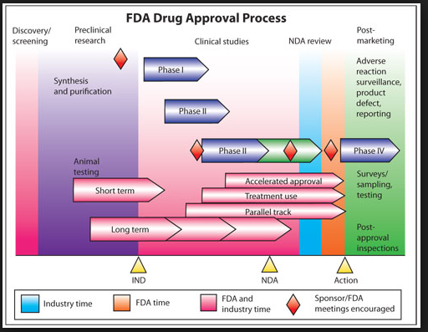
Approval Process

Slide 16
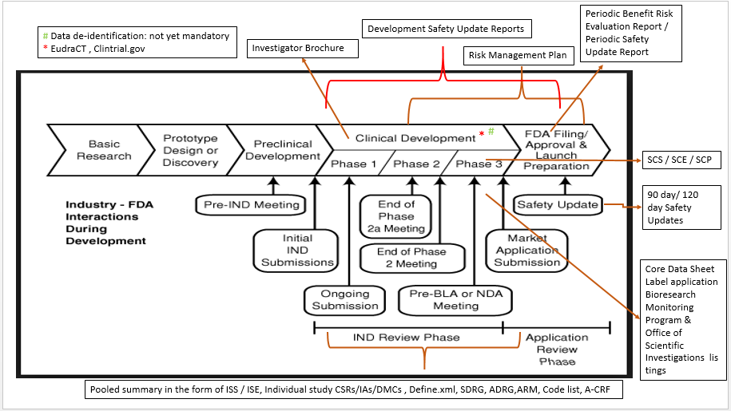
Drug Development and Submission process flow

